Slide 1

Spectral-Blaze: A High-Performance FFT-based CNN Accelerator
20th International Symposium on Applied Reconfigurable Computing-ARC 2024
Shine Parekkadan Sunny
Satyajit Das
Department of Computer Science & Engineering
Indian Institute of Technology (IIT) Palakkad
Kerala, India
112014002@smail.iitpkd.ac.in
Department of Computer Science & Engineering
Indian Institute of Technology (IIT) Palakkad
Kerala, India
satyajitdas@iitpkd.ac.in
Notes:
Hi All,
I am shine sunny, A Research scholar in Dept. of computer science and engineering, Indian institute of Technology Palakkad, India. This work has been carried out in guidance of Dr. Satyajit Das, Assistant professor from same dept.
Welcome to our presentation about Spectral-Blaze: A high throughput FFT-based CNN Accelerator

Slide 2


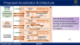



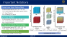







Outline of Presentation
Introduction
Experiments & Results
Proposed Approach
Motivation & Related Works
Conclusion
Performance
Performance Benchmark
Setup
Algorithmic Improvements
Architecture: 1. Forward FFT 2. HPG 3. Inverse FFT
Novelties
Background
Outline
Notes:
The outline of my presentation goes like this: In the first section, I will speak about the context of AI acceleration at the edge. Later, I will discuss motivation behind our research problem and a few important past works. After that, I will discuss our major contributions. Later I will present our proposed Algorithm-Architecture Co-design along with some background concept. I will then speak about the experiments we conducted and the results we obtained. Finally, we will conclude with the key observations.

Slide 3
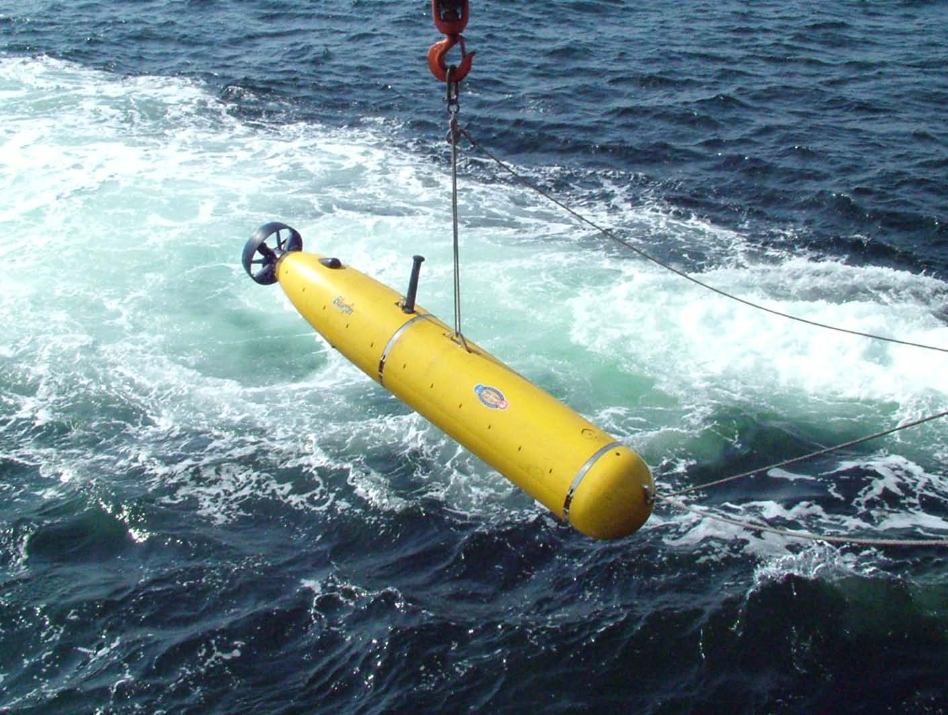
Introduction
Size
Power
Realtime
DNN Inference acceleration
Constraints
Robotics
ADAS
NLP
Why Edge?
Real-time
Privacy
BW issues
*Picture courtesy: Wikipedia
*Picture courtesy: Wikipedia
Introduction
Notes:
As you all already know, deep learning has found extensive applications in fields such as robotics, autonomous driver-assist systems, and natural language processing owing to its high accuracy. Many of these applications require low-latent responses during the inference stage. However, due to the nature of these applications, the processing hardware is subject to stringent constraints with regards to size and power consumption.

Slide 4
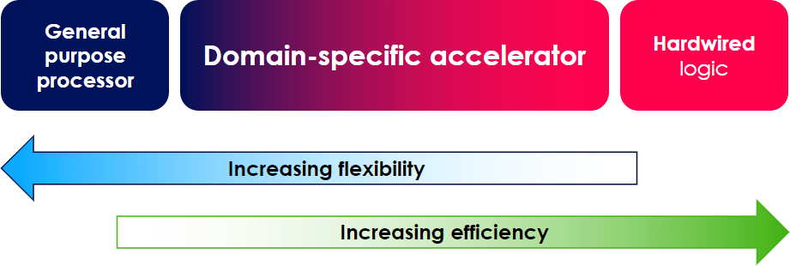
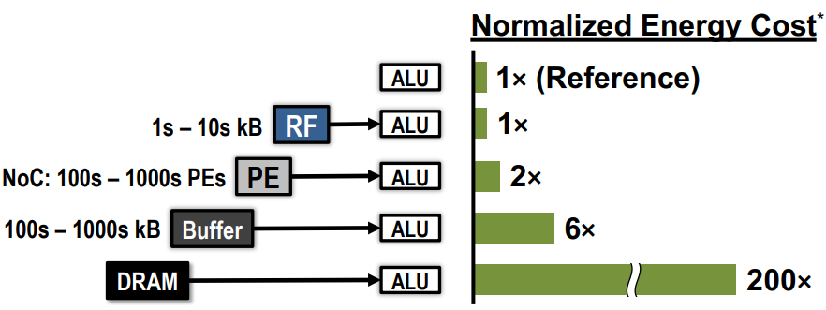
Domain Specific Accelerators
Why not general purpose processor?
Leakage current>switching current
Max clock levelling out
Moore's Law is starting to fail
Increasing complexity of DNN models
*Picture courtesy: Yu-Hsin Chen et al. “Eyeriss: An Energy-Efficient Reconfigurable Accelerator for Deepconvolutional Neural Networks”. In: IEEE Journal of Solid-State Circuits
In a post-Dennard, post-Moore world, further processor specialization will be needed to achieve performance improvements
Data Movement Energy Cost*
Introduction
Notes:
In a post moore post-dennard world, domain specific accelerators are developed to cope up with increasing complexity of DNN models.
Another important observation is that , If we analyze a processing HW by consumed energy, memory transaction are far more energy-intensive than compute operations. In terms of energy, off-chip memory access is the costliest transaction. So, effective caching of data is a critical aspect for a low power & high throuput processing HW.

Slide 5
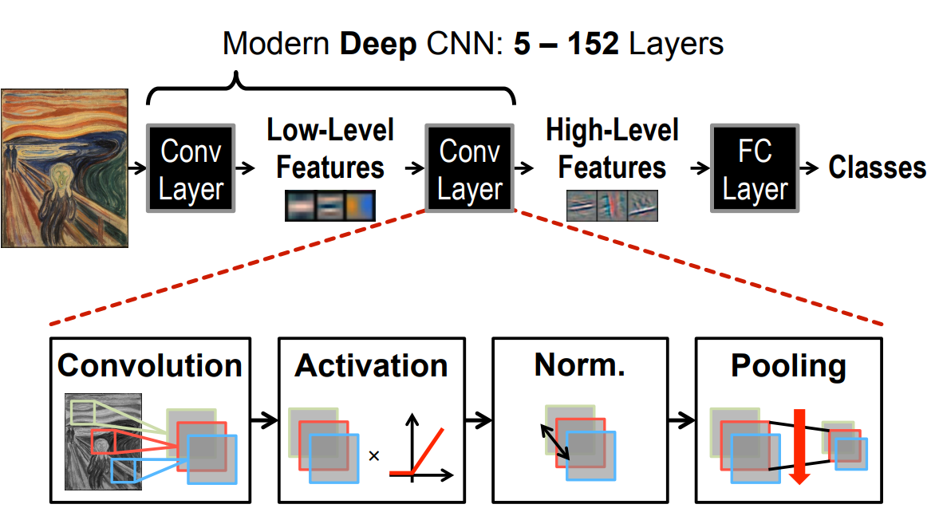

Overview of CNN Networks
*Picture courtesy: Yu-Hsin Chen et al. “Eyeriss: An Energy-Efficient Reconfigurable Accelerator for Deep convolutional Neural Networks”. In: IEEE Journal of Solid-State Circuits
In modern DNNs, CNN layer has 80-90% of Computations, Runtime and DRAM transactions
Introduction
Notes:
A CNN is composed of two basic parts named as feature extraction and classification. Feature extraction includes several convolution layers which extracts the hierarchical features followed by max-pooling and an activation function. The classifier usually consists of fully connected layers.
CNNs are most widely used DNN architecture particularly in the applications, I have discussed. Studies have shown that nearly 90% of compute involved in CNN is convolution.

Slide 6


Outline of Presentation
Introduction
Experiments & Results
Proposed Approach
Motivation & Related Works
Conclusion
Performance
Performance Benchmark
Setup
Algorithmic Improvements
Architecture: 1. Forward FFT 2. HPG 3. Inverse FFT
Novelties
Background
Outline
Notes:
The outline of my presentation goes like this: In the first section, I will speak about the context of AI acceleration at the edge. Later, I will discuss motivation behindour research problem and a few important past works. After that, I will present our proposed Algorithm-Architecture Co-design. I will then speak about the experiments we conducted and the results we obtained. We will also compare a few works with ours. Finally, we will conclude with the key observations.

Slide 7
Challenges in Spatial Accelerator
ofmap = convolution(ifmap,wt)
for (int n = 0; n < N; n++) //Across Batch
for (int i = 0; i < IFS - FS + 1; i++) //Across ofmap x direction
for (int j = 0; j < IFS - FS + 1; j++) //Across ofmap y direction
for (int oc = 0; oc < OC; oc++) //Across output channel
for (int c = 0; c < IC; c++) //Across input channel
for (int fi = 0; fi < FS; fi++) //Across weight x direction
for (int fj = 0; fj < FS; fj++) //Across weight y direction
ofmap[n][i][j][oc] += ifmap[n][i + fi][j + fj][c]*wt[fi][fj][c][oc]
Limited on-chip storage
Tensors has to be partitioned to accommodate in on-chip storage
Results in redundant data movement for convolution
Motivation & Related Works
Notes:
The CNN computation in a layer can be shows as in the pseudo-code. Generally, tensors has to be partitiooned so as to fit in the on-chip memory resulting in redunandat memory transactions. Tiling is a complex problem in spatial accelerators as it depends on multiple factors. .

Slide 8
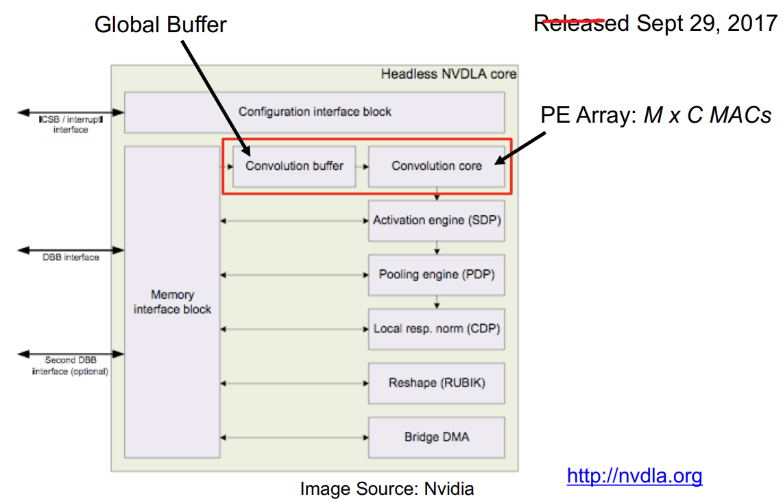
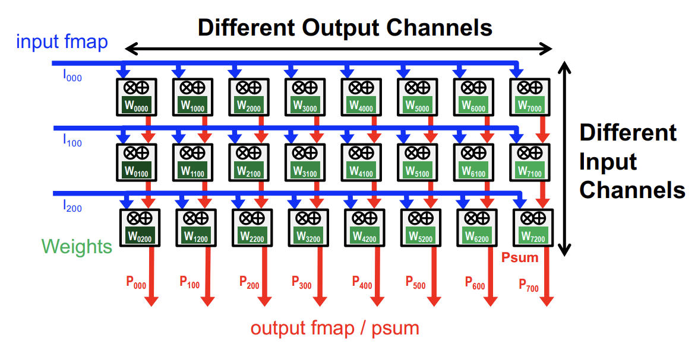
Challenges in Spatial Accelerator (NVDLA:WS)
Under utilised PE’s depending on layer shape
Good chance of IC < C & OC < M, affects tiling decisions
Parallelization across IC & OC
Motivation & Related Works
Notes:
Another challenge is the under-urlisation of PE’s. Let us take the case of NVDLA, a popular DL accelerator from NVIDIA where computations are unrolled across input & output channels . Here, Depeneing on the layer dimenstionsa , It can happen that a small subset of processing engines will be. For example VGG 1st layer, ic = 3 resulting in severe underutilisation. Another problem arising with this kind of parallelization is a fixed dataflow. In this case weights are always stationed inside the on-chip memory exploting primarily the reuse opportunities of only the weight. (convolutional reuse). But these opportunities are very less when we go deeper or have a small batch size.

Slide 9
Major Prior Works
Vivienne et al. (2017) identifies FFT as one of the transform methods to speed up the computations in a CNN layer [1]
Abtahi et al. (2018) compares three convolution techniques, namely, Direct-Conv, FFT-Conv, and FFT-OVA-Conv on multiple embedded device [3]
The benefits of FFTs decrease with filter size
The size of the FFT is dictated by the output feature map size which is often much larger than the filter
The coefficients in the frequency domain are complex.
Chitsaz et al. (2020) introduces the concept of split convolution using FFT [2]
The overlap & Discard convolution achieved further reduction in additions compared to FFT-OVA-Conv
The work concludes that the FFT-OVA-Conv achieves the highest throughput and lowest energy consumption.
Yixin (2023) proposes an FFT based kernel sharing method [8]
Concentrated only on reusing WT tensor
Prior works focus more on the computational aspects of convolution without considering dataflow, tiling , reuse opportunities ...
Motivation & Related Works

Slide 10
Novelties
A Comprehensive Architecture addressing multiple aspects of FFT-based CNN acceleration
Spectral-Blaze addresses minimisation of off-chip memory access, efficient FFT/IFFT Computations, Tiling in frequency domain, Parallelization and Dataflow
Proposed a Modified approach for OaD Convolution
Generally, the proposed approach has lower number of real-multiplication than spatial computations even for compact filters
Proposes a new parallelization scheme named as Intra-patch parallelization
The proposed parallelisation is across the elements of patch
Solves the fundamental problem of under-utilsation of PE’s in spatial accelerator with respect to layer shape
Novelties
Notes:
These are the key novelties.

Slide 11
Novelties
Proposes a new dataflow scheme named as flex-stationary
The dataflow scheme can adaptively place the operand in on-chip memory so as to enhance reuse
Tiling
Tiling in spatial domain often requires complex optimisation strategies
Spectral-Blaze introduces a simple greedy tiling approach in frequency domain keeping the avg. reuse factor high.
Optimized FFT/IFFT Process
Proposes a modified row-column FFT which saves on fetching & computations in the overlapped portion
Real-FFT based optimizations improving on storage & calculations
Vector-radix IFFT which saves a complex multiplication in butterfly
Novelties
Notes:
These are the key novelties.

Slide 12
Outline of Presentation
Introduction
Experiments & Results
Proposed Approach
Motivation & Related Works
Conclusion
Performance
Performance Benchmark
Setup
Algorithmic Improvements
Architecture: 1. Forward FFT 2. HPG 3. Inverse FFT
Novelties
Background
Outline
Notes:
The outline of my presentation goes like this: In the first section, I will speak about the context of AI acceleration at the edge. Later, I will discuss motivation behindour research problem and a few important past works. After that, I will present our proposed Algorithm-Architecture Co-design. I will then speak about the experiments we conducted and the results we obtained. We will also compare a few works with ours. Finally, we will conclude with the key observations.

Slide 13
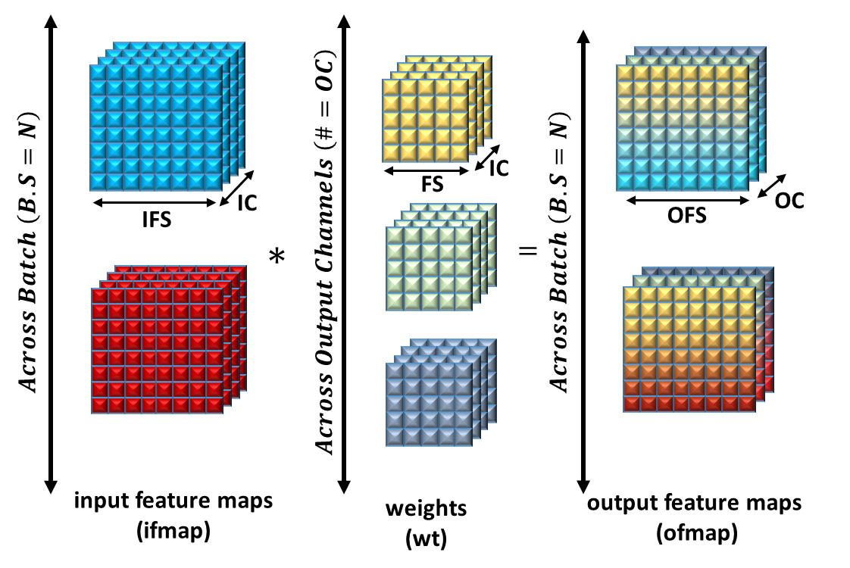
Important Notations
Ifmap tensor (Input Feature Map)
wt tensor (Weight)
ofmap tensor (Output Feature Map)
4-dimensional tensor ($IFS∗IFS∗IC∗N$)
4-dimensional tensor (𝐼𝐹𝑆∗𝐼𝐹𝑆∗𝐼𝐶∗𝑁)
IC : Input Channels
N : # of ifmaps in a batch
4-dimensional tensor ($FS∗FS∗IC∗OC$)
4-dimensional tensor (𝐹𝑆∗𝐹𝑆∗𝐼𝐶∗𝑂𝐶)
FS : WT Size (Generally a square matrix)
4-dimensional tensor ($OFS∗OFS∗OC∗N$)
4-dimensional tensor (𝑂𝐹𝑆∗𝑂𝐹𝑆∗𝑂𝐶∗𝑁)
OFS :Output fmap Size (square matrix)
psum tensor (Partial Sum)
Intermediate ofmap in case of tiling
IFS : Input fmap Size (generally a square matrix)
OC : Output Channels
$$IFMAP= FFT\left(ifmap\right) WT= FFT\left(wt\right) OFMAP= FFT\left(ofmap\right)$$
Convolution & Tensors
Background
Notes:
These are the few important notations used throughout this presentation. In a CNN computations, we are dealing primarily with three tensors/multidimensional array. Capital letter represents the frequency domain. Partial sum represents the case when the input channels are not fully considered.

Slide 14
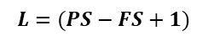
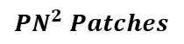
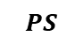
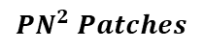
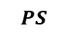


Overlap & Discard Convolution (OaD)
Col.wise overlap (FS-1)
Hadamard Product
PS
IFS
PS
$$PS=L+(FS−1)$$
(WT is pre-calculated)
OFS
IFMAP
OFMAP
$$L$$
FFT
IFFT
$$L=(PS−FS+1)$$
Row.wise overlap (FS-1)
$$PS$$
Discarded Edge Effects
$$PS$$
IC
ifmap
OC
ofmap
$${PN}^{2} Patches$$
IC
IC
$${PN}^{2} Patches$$
WT
Computation scales logarithmically w.r.t weight size
Background
Notes:
We have identified the overlap & discard method as the basic convolution approach. The ifmap is partitioned into smalle overlapping patches. The FFT is taken on this oatches and is point-wise multiplied by the FFT of the WT oatch . Later an IFFT is taken and removed the edge effects. And an ofmap is formed.

Slide 15
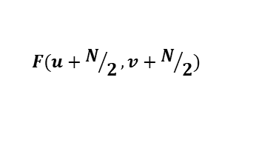
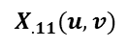
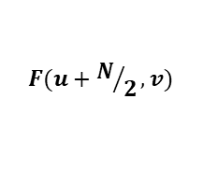
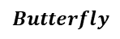
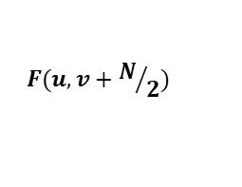
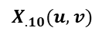
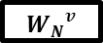
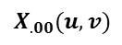
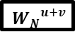
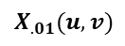
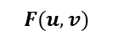
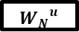
Concept of Vector-Radix FFT
Absence of CMUL in this path
Conventional 2-D FFT
Uses row-wise FFT’s then column-wise FFT’s resulting in $2n$ 1-D FFT’s
Uses row-wise FFT’s then column-wise FFT’s resulting in 2𝑛 1-D FFT’s
$$\# CMUL^{′}s=2n∗\left(\frac{n}{2}\log_{2}{n}\right)$$
# 𝐶𝑀𝑈𝐿^′ 𝑠=2𝑛∗(𝑛/2 log_2⁡𝑛 )
Vector-Radix 2-D FFT
Recursively breaks the FFT into smaller 2-D FFTs
Combinations are $\left\{\left(e,e\right),\left(e,o),\right. \left(o,e),\right.\text{(}o,o)\right\}$
Combinations are {(𝑒,𝑒),(𝑒,𝑜),┤" " (𝑜,𝑒),┤"(" 𝑜,𝑜)}
Saves a single CMUL in a butterfly
$$\# CMUL^{′}s={\frac{3}{4}n}^{2}\log_{2}{n}$$
# 𝐶𝑀𝑈𝐿^′ 𝑠=〖3/4 𝑛〗^2 log_2⁡𝑛
$$= n^{2}\log_{2}{n}$$
= 𝑛^2 log_2⁡𝑛
3 CMUL’s in a butterfly
$$Butterfly$$
$$X_{.00}(u,v)$$
+
+
$$F(u,v)$$
+
+
$$X_{.01}(u,v)$$
$${W_{N}}^{v}$$
+
+
$$F(u,v+N/2)$$
-
+
$$X_{.10}(u,v)$$
$${W_{N}}^{u}$$
+
+
$$F(u+N/2,v)$$
+
-
$$X_{.11}(u,v)$$
$${W_{N}}^{u+v}$$
+
+
$$F(u+N/2,v+N/2)$$
-
-
1.33x improvement in operational count & effective utilisation smaller on-chip memory chunks
Background

Slide 16
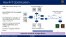

Outline of Presentation
Introduction
Experiments & Results
Proposed Approach
Motivation & Related Works
Conclusion
Performance
Performance Benchmark
Setup
Algorithmic Improvements
Architecture: 1. Forward FFT 2. HPG 3. Inverse FFT
Novelties
Background
Outline
Notes:
The outline of my presentation goes like this: In the first section, I will speak about the context of AI acceleration at the edge. Later, I will discuss motivation behindour research problem and a few important past works. After that, I will present our proposed Algorithm-Architecture Co-design. I will then speak about the experiments we conducted and the results we obtained. We will also compare a few works with ours. Finally, we will conclude with the key observations.

Slide 17

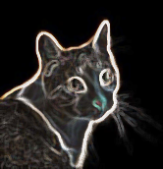
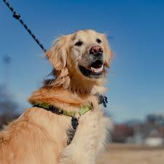
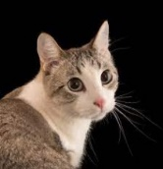
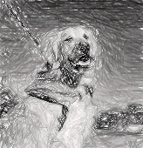
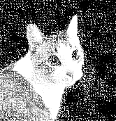


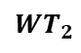
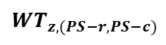
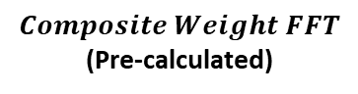
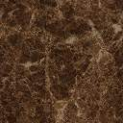
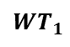
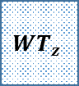
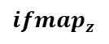
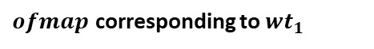
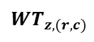
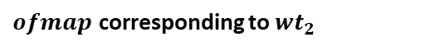
Real FFT Optimization
Produces 4 ofmaps by storing a single complex ifmap and a complex wt
Enhances Throughput & Reuse Factors
CNN deals with real ifmap & real weight
Hence IFMAP & WT are conjugate symmetric
By combining two real data , we can compute two real FFT by a single complex FFT
$ofmap$ corresponding to ${wt}_{1}$
$$Re$$
$$Im$$
$$Composite Weight FFT$$
(Pre-calculated)
IFFT
$$Re$$
$${WT}_{1}$$
$${WT}_{z,(r,c)}$$
>> 1
$${WT}_{z}$$
$${ifmap}_{z}$$
FFT
$${WT}_{2}$$
$${WT}_{z,(PS−r,PS−c)}$$
>> 1
*j
$$Im$$
IFFT
FFT
$$Re$$
$$Im$$
$$Im$$
$${wt}_{z}$$
$$Re$$
$ofmap$ corresponding to ${wt}_{2}$
Proposed real FFT based computations
Improves runtime & storage efficacy
Proposed System Architecture

Slide 18
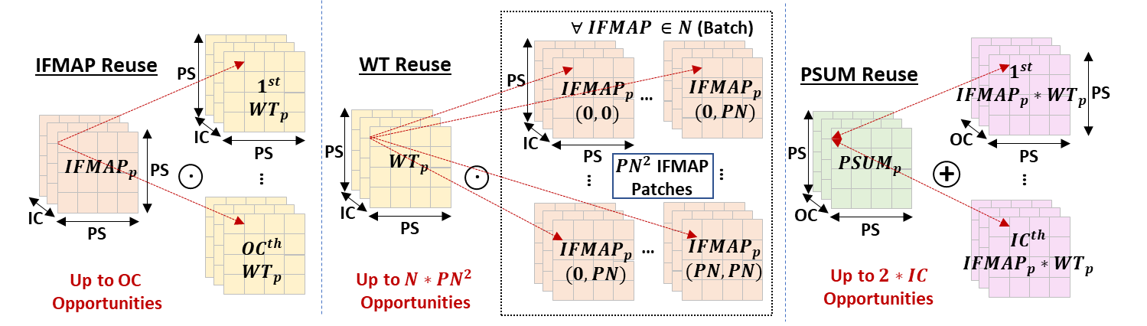
Reuse Opportunities in Freq. Domain
Equal Reuse Opportunities across patch elements
Proposed System Architecture

Slide 19

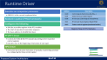
Proposed Accelerator Architecture
Processing System(PS)
PL
32-bit AXI Lite
AXI Lite R/W
Registers
Processor & Associated Driver
(Connects to the AXI-Lite interface of released modules)
$${ifmap}_{1}\left(x,y\right)+{j∗ifmap}_{2}(x,y)$$
LW-SG
DMA
(512-bit)
Row-Column Pipelined
2D-FFT
$$\# of iteration={ic∗pn}^{2}$$
Read Channel
Write Channel
$${IFMAP}_{z}(u,v)$$
FFT,HPG & IFFT can work independently across layers
forming a layer-wise task-level pipeline achieving higher throughput
32-bit AXI Lite
AXI Lite R/W
Registers
DRAM Controller
(Connects to the AXI-MM R/W ports of the realised modules)
LW-SG
DMA
(512-bit)
HPG
$$\# of iteration={ic}_{tile}∗{oc}_{tile}∗{pn}_{tile}$$
$${IFMAP}_{z}(u,v)$$
$${WT}_{z}(u,v)$$
Read Channel
$$PSUM_IN(u,v)$$
Write Channel
$$PSUM_OUT(u,v)$$
32-bit AXI Lite
AXI Lite R/W
Registers
LW-SG
DMA
(512-bit)
${OFMAP}_{z}(u,v)$
6-Staged Pipelined
2D VR IFFT core
$$\# of iteration={oc∗pn}^{2}$$
Read Channel
Write Channel
$${ofmap}_{1}\left(x,y\right)+{j∗ofmap}_{2}(x,y)$$
Proposed System Architecture
Notes:
This is the proposed architecture realised on a zynq mpsoc based FPGA.FFT,HPG, IFFT will be happening in a layer-wise pipelined fashion in the PL portion using DRAM as an intermediary for high throuput. The control is from the PS

Slide 20

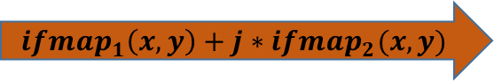
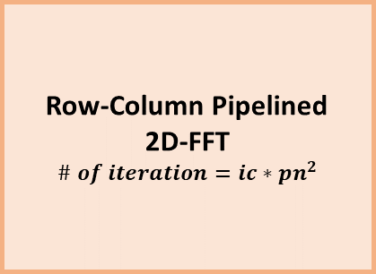
Forward FFT Module
Fetches the ifmap
Reorders in a patched fashion
Partition into overlapping patches
Column-buffers for storing overlapping columns
Row-wise FFT
Pipelined 6-stage 1-D FFT
Looped for (PS-FS+1) times
Transpose
Column-wise FFT
Pipelined 6-stage 1-D FFT
Looped for PS times
Memory write
Transposed write to DRAM
Row-buffers for storing FFT of overlapped rows
FFT of patch written to memory(IFMAP)
Processing System
AXI Lite R/W
Registers
Processor & Associated Driver
32-bit AXI Lite
AXI-4 MM
Master
R/W
512-bit
$${ifmap}_{1}\left(x,y\right)+{j∗ifmap}_{2}(x,y)$$
Row-Column Pipelined
2D-FFT
$$\# of iteration={ic∗pn}^{2}$$
Read Channel
DRAM
Write Channel
$${IFMAP}_{z}(u,v)$$
$${ifmap}_{1}\left(x,y\right),{ifmap}_{2}\left(x,y\right)∈Batch of ifmaps(ic)$$
FWD FFT Module
Achieves high throughput with minimal FPGA resources
Proposed System Architecture

Slide 21










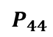
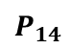
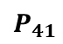

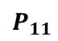


Process of FWD FFT
IFMAP ROW
$$\left(PS−FS+1\right)$$
$$pixels$$
$${pix}_{11}$$
$${pix}_{11}$$
Column overlapping
PIPO
$$P_{11}$$
…
$$P_{14}$$
1
Burst Read &
Buffering
$${BRAM}_{0}$$
Read Patch
$${ifmap}_{z}={ifmap}_{1}+j {ifmap}_{2}$$
$${pix}_{44}$$
$${pix}_{44}$$
…
Patches
1 -> 2
$${BRAM}_{1}$$
…
IFMAP ROW
$${pix}_{11}$$
$${pix}_{11}$$
Patch Generator
(Fetching & Partitioning)
$$P_{41}$$
…
$$P_{44}$$
2
Col.wise overlap
$${pix}_{44}$$
$${pix}_{44}$$
Zero Padding
PS
Transpose
…
Zero Padded
FFT
$${OP}_{11}$$
$${OP}_{14}$$
1st Row. wise 1-D FFT
2-D FFT Output
Col. wise overlapped
Patches
…
…
PS
(FS-1)
Overlapped FFT portion (Buffered)
$${OP}_{41}$$
…
O$P_{44}$
PS
Row-Column 2-D FFT
2nd Row. wise 1-D FFT
Overlapped portion is buffered to save on redundant DRAM access & FFT computations
Proposed System Architecture

Slide 22





Hadamard Product Generator
Flexible tile fetcher
Fetches the updated patches required for the current iteration as per the tiling schedule
Executes the Complex MAC(CMAC) computation
Intra-patch parallelization
PSUM writer
Writes the PSUM patches to the DRAM
Computation happens across ${OC}_{tile},$ ${IC}_{tile},$ ${PN}_{tile},$
Computation happens across 〖𝑂𝐶〗_𝑡𝑖𝑙𝑒, 〖𝐼𝐶〗_𝑡𝑖𝑙𝑒, 〖𝑃𝑁〗_𝑡𝑖𝑙𝑒,
Stationed patches are unchanged
Happens across ${OC}_{tile},$ ${PN}_{tile}$
Happens across 〖𝑂𝐶〗_𝑡𝑖𝑙𝑒, 〖𝑃𝑁〗_𝑡𝑖𝑙𝑒
Tile Buffer
Reshaped wide memory made up of URAMS
128x parallelization
8 URAM’s are reshaped to enable this
Weight-FFT splitter
Individual weights are extracted from the complex weight FFT
WT is sequentially considered after the weight-fft splitting
Flexible size allocation of on-chip buffer to different operands
Entire sub-patch(parallelization) can be fetched in a single clk
Processing System
AXI Lite R/W
Registers
Processor & Associated Driver
32-bit AXI Lite
AXI-4 MM
Master
R/W
512-bit
HPG Core
$$\# of iteration={ic}_{tile}∗{oc}_{tile}∗{pn}_{tile}$$
$${IFMAP}_{z}(u,v)$$
$${WT}_{z}(u,v)$$
Read Channel
$$PSUM_IN(u,v)$$
DRAM
Write Channel
$$PSUM_OUT(u,v)$$
HPG Module
Proposed System Architecture

Slide 23
















HPG Core
$${WT}_{z,(r,c)}$$
$${WT}_{z1}$$
WT Buffer
(Tile buffer @ wt offset)
>> 1
Parallel CMAC
$${WT}_{z,(PS−r,PS−c)}$$
$${WT}_{z2}$$
*j
>> 1
sub-patch elements
${WT}_{SP}$
${IFMAP}_{SP}$
${PSUM}_{SP}$
${PSUM}_{SP}$
$$OC∗IC$$
WT
$${WT}_{z1}$$
$${WT}_{z}$$
WT FFT
Splitter
I$C∗PN$
PSUM
$${WT}_{z2}$$
$$OC∗PN$$
IFMAP
AXI4-MM
Flexible Tile Fetcher
512-bit
Tile Buffer
Parallel Sub-Patch
CMAC’s (128x)
512-bit
PSUM Tile Writer
AXI4-MM
$${PSUM_IN}_{z}$$
$${PSUM_OUT}_{z}$$
Proposed System Architecture

Slide 24


Proposed Intra-Patch Parallelization
Parallel pt.wise Complex Hadamard product bw IFMAP & WT
Linearise & form sub-patches(LSP) of the order of parallelism
Parallelism can be controlled by LSP size
Parallel complex MAC on LSP
$$LSP_{PS}=PS/SF$$
2-D patches of Operands
WT
IFMAP
PSUM
WT LSP
IFMAP LSP
PSUM LSP
PSUM LSP
Linearised Sub-Patch(LSP) Complex MAC
Theoretical MAC Utilisation of 100% when $\# of MAC^{′}s≤{PS}^{2} (min=64, often>256)$
Proposed System Architecture

Slide 25

Flexible Tile Fetcher
Configurable tile size for each of the operands
Controlled by tiling control register
Flexible dataflow choices
Depends on the control, can be configured as
weight stationary ,input stationary or output stationary
Varies between layers
Proposed System Architecture

Slide 26
Background of Tiling Problem
Sizes of each operands
IFMAP : $ic_{tile}∗pn_{tile}$ ($ic_{tile}≤ic \& {pn}_{tile}≤N∗{PN}^{2}$)
IFMAP : 𝑖𝑐_𝑡𝑖𝑙𝑒∗𝑝𝑛_𝑡𝑖𝑙𝑒 (𝑖𝑐_𝑡𝑖𝑙𝑒≤𝑖𝑐 & 〖𝑝𝑛〗_𝑡𝑖𝑙𝑒≤𝑁∗〖𝑃𝑁〗^2 )
WT: $ic_{tile}∗oc_{tile}$($ic_{tile}≤ic \& {oc}_{tile}≤OC$)
WT: 𝑖𝑐_𝑡𝑖𝑙𝑒∗𝑜𝑐_𝑡𝑖𝑙𝑒 (𝑖𝑐_𝑡𝑖𝑙𝑒≤𝑖𝑐 & 〖𝑜𝑐〗_𝑡𝑖𝑙𝑒≤𝑂𝐶 )
PSUM_IN: ${oc}_{tile}∗pn_{tile}$(${oc}_{tile}≤OC \& {pn}_{tile}≤N∗{PN}^{2}$)
PSUM_IN: 〖𝑜𝑐〗_𝑡𝑖𝑙𝑒∗𝑝𝑛_𝑡𝑖𝑙𝑒(〖𝑜𝑐〗_𝑡𝑖𝑙𝑒≤𝑂𝐶 & 〖𝑝𝑛〗_𝑡𝑖𝑙𝑒≤𝑁∗〖𝑃𝑁〗^2)
Potential reuse opportunities for a layer(cmplx tensors)
IFMAP: can be reused for each of the ofmap channels ($\frac{OC}{2}$)
IFMAP: can be reused for each of the ofmap channels (𝑂𝐶/2)
WT: can be reused for each of the ifmap tiles ($N/2∗{PN}^{2}$)
WT: can be reused for each of the ifmap tiles (𝑁/2∗〖𝑃𝑁〗^2)
PSUM: can be reused for each of the ifmap channels(2*$IC$)
PSUM: can be reused for each of the ifmap channels(2*𝐼𝐶)
Total # of Hadamard products happening in a single iteration
$$oc_tile∗pn_tile∗ic_{tile}$$
𝑜𝑐_𝑡𝑖𝑙𝑒∗𝑝𝑛_𝑡𝑖𝑙𝑒∗𝑖𝑐_𝑡𝑖𝑙𝑒
On-Chip Buffer
$$Max Size ≥( ic_{tile}∗pn_{tile}+ic_{tile}∗oc_{tile}+oc_{tile}∗pn_{tile})∗subptach$$
𝑀𝑎𝑥 𝑆𝑖𝑧𝑒 ≥( 𝑖𝑐_𝑡𝑖𝑙𝑒∗𝑝𝑛_𝑡𝑖𝑙𝑒+𝑖𝑐_𝑡𝑖𝑙𝑒∗𝑜𝑐_𝑡𝑖𝑙𝑒+𝑜𝑐_𝑡𝑖𝑙𝑒∗𝑝𝑛_𝑡𝑖𝑙𝑒)∗𝑠𝑢𝑏𝑝𝑡𝑎𝑐ℎ
Simple greedy tiling, importance to dimensions offering more reuse opportunities
Can choose a smaller sub patch according to the on-chip memory
Proposed System Architecture

Slide 27




Realised Inverse FFT Module on MPSoC
OFMAP Fetcher
Fetches OFMAP produced by complex multiplier from DRAM
IFFT by FFT
VR FFT Core
Pipelined 6-stage variable length 2-D VR FFT
Pipeline in a loop for $OC∗{PN}^{2} times$
Pipeline in a loop for 𝑶𝑪∗〖𝑷𝑵〗^𝟐 𝒕𝒊𝒎𝒆𝒔
IFFT by FFT
Real & imaginary coefficient interchange
Right shift by log of patch size (psl)
Real & imaginary coefficient interchange
Coefficient Separation
Separate real & imaginary coefficients as ofmap pixel of ifmap1 & ifmap2
Processing System
AXI Lite R/W
Registers
Processor & Associated Driver
32-bit AXI Lite
AXI-4 MM
Master
R/W
512-bit
${OFMAP}_{z}(u,v)$
6-Staged Pipelined
2D VR IFFT core
$$\# of iteration={oc∗pn}^{2}$$
Read Channel
DRAM
Write Channel
$${ofmap}_{1}\left(x,y\right)+{j∗ofmap}_{2}(x,y)$$
INV FFT Module
INV FFT by FWD FFT
Proposed System Architecture

Slide 28















Pipelined 6-stage VR FFT Core
Uses Vector-Radix Butterfly for every stages
To enable configurable FFT size
FFT stages will either bypass or execute butterfly based on FFT size
Uses ping-pong buffer between stages for parallel execution
Executes $OC∗{PN}^{2}$ times by pipeline in a loop for a layer
Executes 𝑂𝐶∗〖𝑃𝑁〗^2 times by pipeline in a loop for a layer
Input Buffer
Patch Size(8-bit)
Output Channels(16-bit)
Patch Number (8-bit)
FFT Stage-1
AXI-Lite control Register
PIPO Buffer
$$Butterfly$$
….
$$S_{.00}(x,y)$$
$$X(u,v)$$
+
+
$$S_{.01}(x,y)$$
+
+
$$X(u,v+N/2)$$
$${W_{N}}^{v}$$
+
+
FFT Stage-6
$$S_{.10}(x,y)$$
$${W_{N}}^{u}$$
-
+
$$X(u+N/2,v)$$
+
+
$$S_{.11}(x,y)$$
$${W_{N}}^{u+v}$$
+
-
$$X(u+N/2,v+N/2)$$
+
+
FFT->IFFT
-
-
$$X=S$$
Only 3 CMUL in Butterfly
$$Bypass$$
OR
Utilisation of FFT stage compute units are very high due to pipelining.(No break bw patches)
Activation
Pooling
${…(n+1)}^{th}$ layer
VR-FFT Core
Proposed System Architecture

Slide 29


DNN Mapper/Compiler SW (Static)
HPG
Find’s the optimum patch size of FFT depends on the efficiency criteria
FFT/IFFT
Also computes overlap, patch_no & non-overlapped patch size
Generates the optimal tiling schedule of each layer statically
Tiling schedule consists of the following
# of tiles fetched for each operands(PSUM_IN,IFMAP,WT) for each iteration of the Hadamard Product Generator
Specifies the stationary operands
Tiling schedule optimizes the following
Reuse opportunities of each tile of all the three operands
Favours burst access by fetching contiguous tiles(fixed cost-model)
Maximizes the use of on-chip tile buffer
Reduces DRAM BW
Significant reduction in energy (particularly energy required for DRAM access)
Higher throughput by balancing contiguous access and reuse opportunities
Proposed System Architecture

Slide 30


Runtime Driver
Executes on companion processors
ARM A53 in the current implementation
Realized in python (PYNQ Framework)
Configures the following
FFT/IFFT Driver
Controls the FWD & INV FFT modules by writing to the respective control registers
Executes once in the beginning of execution of each layer
HPG Driver
Instruction by instruction execution of statically created tiling schedule by configuring the tiling control register
AXI-Lite accessible registers in the RTL modules
The start of execution & execution sequence
The base address of AXI-MM interfaces
Address | Description
0x00 | Control signals (Start,Done,Idle,Rdy….)
0x04 | Global Interrupt Enable Register
0x08 | IP Interrupt Enable Register (Read/Write)
0x0c | IP Interrupt Status Register (Read/TOW)
0x10 | Custom control registers(mentioned earlier)
Register Map of RTL Modules
Proposed System Architecture

Slide 31


Outline of Presentation
Introduction
Experiments & Results
Proposed Approach
Motivation & Related Works
Conclusion
Performance
Performance Benchmark
Setup
Algorithmic Improvements
Architecture: 1. Forward FFT 2. HPG 3. Inverse FFT
Novelties
Background
Outline
Notes:
The outline of my presentation goes like this: In the first section, I will speak about the context of AI acceleration at the edge. Later, I will discuss motivation behindour research problem and a few important past works. After that, I will present our proposed Algorithm-Architecture Co-design. I will then speak about the experiments we conducted and the results we obtained. We will also compare a few works with ours. Finally, we will conclude with the key observations.

Slide 32
Experimental Setup
Benchmarked against 7 different accelerators
Eyeriss (RS Dataflow), MAERI, Flexflow, Yixin + Zhang et. al
Accelerators modelled to have similar HW resources
$\# of PE’s ≅MAC’s$, $L2 Size ≅(BRAM+URAM size)$
# 𝑜𝑓 𝑃𝐸’𝑠 ≅𝑀𝐴𝐶’𝑠, 𝐿2 𝑆𝑖𝑧𝑒 ≅(𝐵𝑅𝐴𝑀+𝑈𝑅𝐴𝑀 𝑠𝑖𝑧𝑒)
Experimented on
All 13 convolution layers of VGG16 (Diverse layer shapes & smaller filter size), Resnet-18. Alexnet, Zfnet
Energy consumption
Based on avg. activity factors and # of memory transactions
Accuracy
No drop in classification accuracy in a subset of Imagenet dataset
Off Chip BW = 512-bit wide (32 elements/cycle), Precision = 16-bit float
Experiments & Results

Slide 33
Layer-Wise Comparison of RMUL's for VGG16
Improvement ranges from 1.93x-5.19x and gets better when IC or OC is higher
Experiments & Results
Notes:
We have compared the proposed modified OaD method against other apparoches for the VGG-16 convolution layers.

Slide 34
Reuse Factors with Complex Tensors
 | IFMAP |  | WT |  | PSUM
Layer Name | Avg. | Max. | Avg. | Max. | Avg. | Max.
conv_1 | 32 | 32 | 2048 | 2048 | 3 | 3
conv_2 | 32 | 32 | 2048 | 2048 | 64 | 64
conv_3 | 32 | 64 | 512 | 512 | 64 | 64
conv_4 | 21.33333 | 64 | 512 | 512 | 128 | 128
conv_5 | 21.33333 | 128 | 128 | 128 | 128 | 128
conv_6 | 128 | 128 | 21.33333 | 128 | 256 | 256
conv_7 | 128 | 128 | 21.33333 | 128 | 256 | 256
conv_8 | 256 | 256 | 10.66667 | 32 | 256 | 256
conv_9 | 256 | 256 | 10.66667 | 32 | 512 | 512
conv_10 | 256 | 256 | 10.66667 | 32 | 512 | 512
conv_11 | 256 | 256 | 8 | 8 | 512 | 512
conv_12 | 256 | 256 | 8 | 8 | 512 | 512
conv_13 | 256 | 256 | 8 | 8 | 512 | 512
VGG16 Reuse factors for various operands
100% reuse on operands having highest reuse opportunities, tiling affects only the reuse opportunities of least used operands
Experiments & Results

Slide 35
Benchmark against SOTA FFT Accel.
 | Yixin [8] |  | Proposed
 | VGG-16 | Alexnet | VGG-16 | Alexnet
 | Activity Count Based Energy Estimate (GLB+SPAD+NOC+MACS)
nano Joules | 1.20E+08 | 1.31E+07 | 2.37E+07 | 4.80E+06
Energy Gain | 5.05 | 2.72 | - | -
 | Performance
Initiation Interval (Cycles) | 1.39E+09 | 3.12E+07 | 2.80E+08 | 1.90E+07
Perf. Gain | 4.98 | 1.64 | - | -
 | Energy-Delay Product
Joule*Sec | 8.34E-01 | 2.04E-03 | 3.32E-02 | 4.56E-04
EDP Gain | 25.14 | 4.47 | - | -
Avg. speedup of 3.31x over Yixin
EDP Improvement upto 25.14x over Yixin
Experiments & Results

Slide 36
Benchmark against SOTA Spatial Accel.
Eyeriss [7] |  |  |  | Maeri [5] |  |  |  | Flexflow [4] |  |  |  | Proposed
VGG 16 | Alex net | Res net18 | ZF Net | VGG 16 | Alex net | Res net18 | ZF Net | VGG 16 | Alex net | Res net18 | ZF Net | VGG 16 | Alex net | Res net18 | ZF Net
Energy in mJ
38.6 | 4.2 | 3.2 | 3.6 | 113 | 19.1 | 9.8 | 15.9 | 35.1 | 4.2 | 3 | 3.3 | 23.7 | 4.8 | 2.5 | 4.2
Performance (II in million clk cycles)
4100 | 91.8 | 129 | 84.5 | 8290 | 206 | 283 | 196 | 3961 | 89 | 125 | 81.9 | 280 | 19 | 33.9 | 32.3
Energy-Delay Product (mJ*Sec)
790 | 1.9 | 2.1 | 1.5 | 4680 | 19.7 | 13.9 | 15.6 | 696.8 | 1.9 | 1.8 | 1.4 | 33.2 | 0.5 | 0.4 | 0.7
EDP Gain
23.8 | 4.23 | 4.98 | 2.26 | 140.92 | 43.05 | 33.39 | 22.86 | 20.98 | 4.05 | 4.52 | 1.98 | - | - | - | -
EDP improvement of 8.82 over Eyeriss and 7.87 over Flexflow
Experiments & Results

Slide 37
Conclusion
Despite having a compact filter size in VGG-16, Spectral-Blaze reduces the number of MAC operations in convolution by 4.59x
The tiling scheme proposed by the Spectral-Blaze architecture maintains reuse factors across dimensions that offer more opportunities and only perform tiling in the dimensions with the lowest reuse.
The design of Spectral-Blaze better utilizes the MAC units, outperforming spatial accelerators by utilizing them up to 63.48% more effectively.
Spectral-Blaze achieves an impressive speedup of 4.98× for VGG-16 and 1.64× for AlexNet compared to the SOTA frequency domain accelerator.
The EDP varies between 4.47 - 25.14× compared to Yixin
Conclusion

Slide 38
Major References
Vivienne Sze, Yu Hsin Chen, Tien Ju Yang, and Joel S. Emer. Efficient processing of deep neural networks: A tutorial and survey, 12 2017.
K. Chitsaz, M. Hajabdollahi, N. Karimi, S. Samavi, and S. Shirani, “Acceleration of convolutional neural network using fft-based split convolutions.”
Tahmid Abtahi, Amey Kulkarni, and Tinoosh Mohsenin. Accelerating convolutional neural network with FFT on tiny cores. In 2017 ISCAS. IEEE.
Wenyan Lu, Guihai Yan, Jiajun Li, Shijun Gong, Yinhe Han, and Xiaowei Li. Flexflow: A flexible dataflow accelerator architecture for convolutional neural networks. In 2017 IEEE International Symposium on High Performance Computer Architecture (HPCA), pages 553–564, Feb 2017.
Hyoukjun Kwon, Ananda Samajdar, and Tushar Krishna. Maeri: Enabling flexible dataflow mapping over dnn accelerators via reconfigurable interconnects. SIGPLAN Not., 53(2):461–475, mar 2018.
Hyoukjun Kwon, Prasanth Chatarasi, Vivek Sarkar, Tushar Krishna, Michael Pellauer, and Angshuman Parashar. MAESTRO: A data-centric approach to understand reuse, performance, and hardware cost of DNN mappings. 40(3):20–29.
Yu-Hsin Chen, Tushar Krishna, Joel S. Emer, and Vivienne Sze. Eyeriss: An energy-efficient reconfigurable accelerator for deep convolutional neural networks. IEEE Journal of Solid-State Circuits, 52(1):127–138, January 2017.
Bosheng Liu, Hongyi Liang, Jigang Wu, Xiaoming Chen, Peng Liu, and Yinhe Han.Accelerating convolutional neural networks in frequency domain via kernel-sharing approach. In 2023 28th Asia and South Pacific Design Automation Conference. (ASP-DAC), pages 733–738, Jan 2023.

Slide 39
Thank You
For Your Attention

